Slide 1
How to read input shaper graphs: a work in progress
Compilation by Reth (the original Reth)
Data taken from:
3D Printers & a whiteboard How to Read and Analyze Input Shaper Graphs Generated by Klipper – YouTube
Felix Boisselier (Frix_x): klippain/docs/input_shaper.md at main · Frix-x/klippain · GitHub
Reth’s Voron Trident – serial 1190
Lots of members of the Voron Community
Version 4-24-2024

Slide 2
Introduction
The following graphs are only applicable to CORE XY printers. Bed slinger, delta, or other style printers will not necessarily be able to match the graphs to mechanical issues as the basic design of the printers are different.
The purpose of these slides are to present different belt shaper and input shaper graphs with some suggestions on how to go about diagnosing and fixing the issue.
These graphs were taken from 3D Printers & a whiteboard,Frix_x, my own Trident 350, and members of the Voron Community with annotations provided for clarity.
Interpretation of input shaper graphs may not be straight forward and it is possible to have multiple issues happening at the same time
Note: tighter belt tension is not always the answer. Tightening belts to much can lead to new, and not better, print artifacts.

Slide 3
Common Issues
Belts are showing two spikes, three spikes, one spike, etc.
“Ideally” you want belt shaper to have a single peak for A and B belts.
However, having two spikes, or even three spikes, may not be an issue.
Belt shaper is used mainly for determining if the belts have the same relative belt tension, and by itself is not a great troubleshooting tool for anything other than relative belt tension.
Need to run input shaper to confirm an issue.
Belt shaper and/or input shaper shows a problem do I need to do a test print.
Begrudgingly yes. Why, sometimes input shaper can just be wrong. This is because input shaper is done by an ADXL and if the ADXL is not mounted correctly/tightly/ect. then it will not be able to produce good graphs. We need a print to verify the accuracy of what input shaper is reporting.
Input shaper says I can do 1 million accel.
You are most likely looking at ZV. It is not recommended to use. This is because it is a really narrow shaper, basically only canceling the main peak. You might be thinking I have really great graphs I only have a main peak. This may not always be the case. Input Shaper only moves in a very small section of the toolheads total movement. There could be vibrations outside of this movement, belts could stretch overtime, the earths magnetic field could collapse. To be better safe than sorry Klipper recommends you use MZV. Further, I have yet to see a ZV shaper return 0% vibr.

Slide 4
Belt Shaper

Slide 5
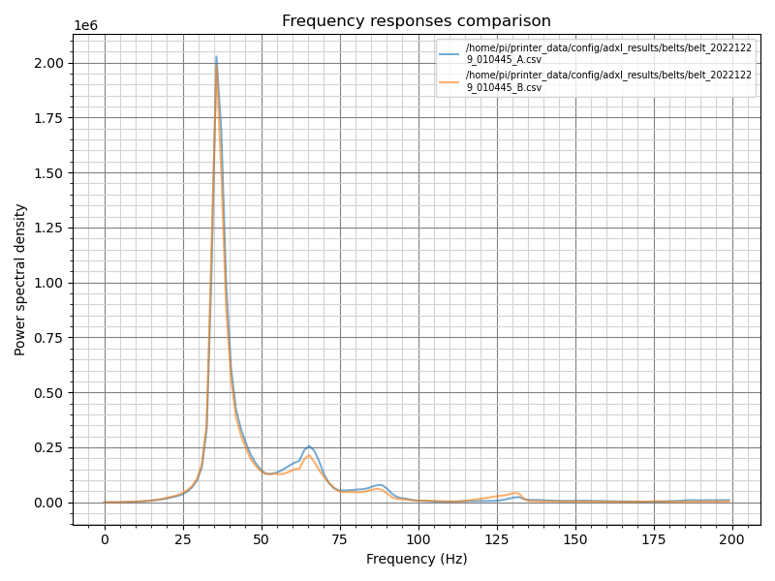
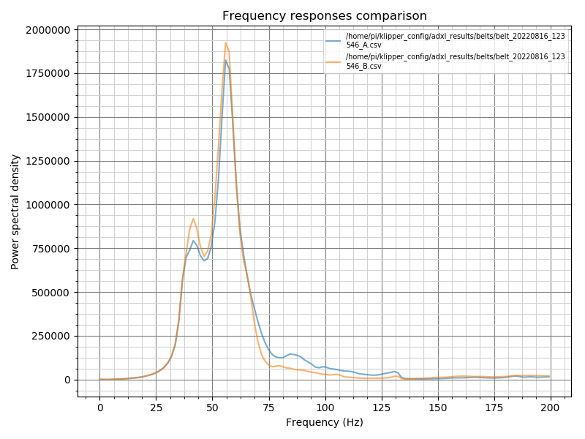
Good belt graphs peaks in freq are aligned

Slide 6
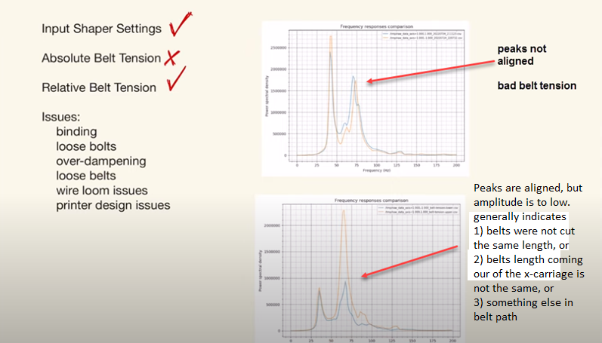
Belt Tension

Slide 7
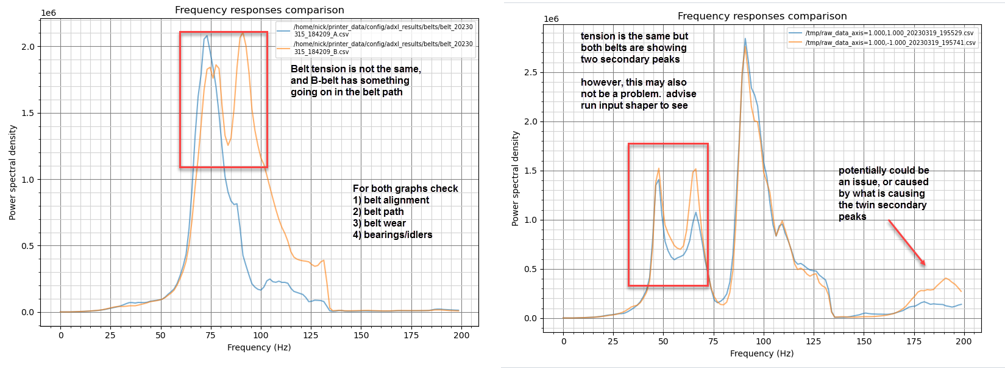
Belt Path problem
For graphs such as this it is recommended to run input shaper to troubleshoot any issues, and determine if the belt path is a problem

Slide 8
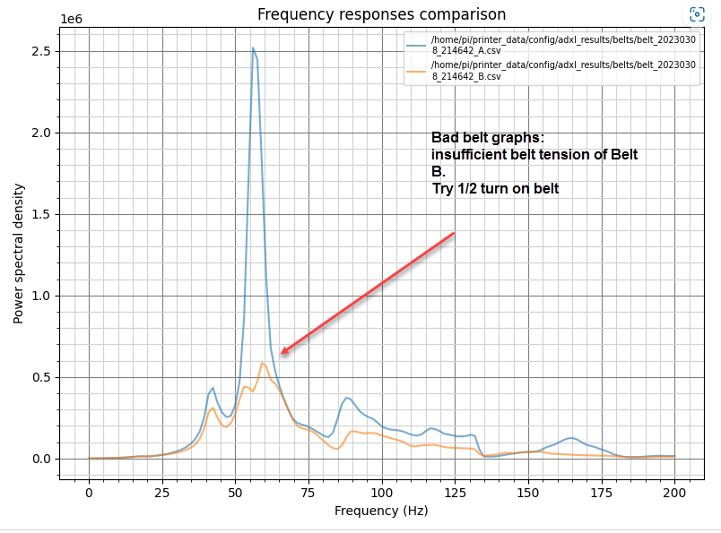
Belt Tension

Slide 9
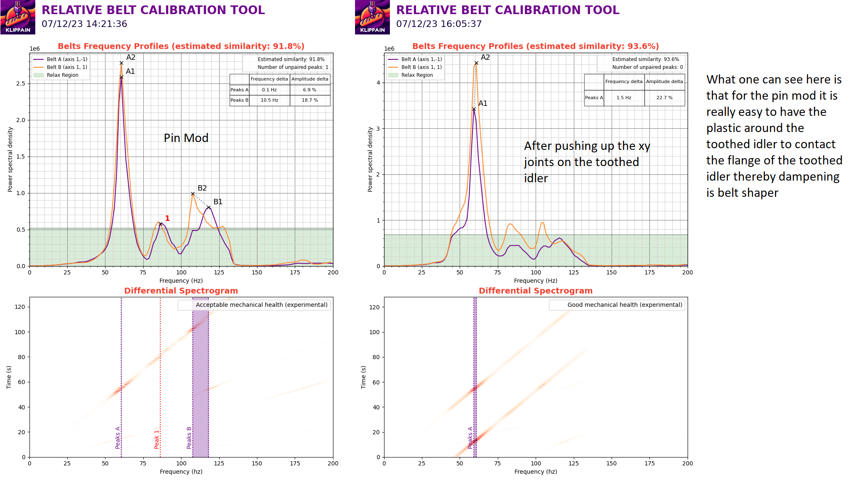
Pin Mod: may need to push up the xy joint around the idler

Slide 10
Input shaper

Slide 11
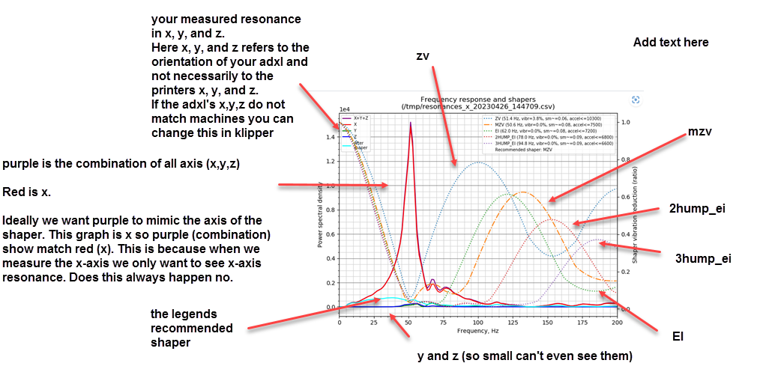
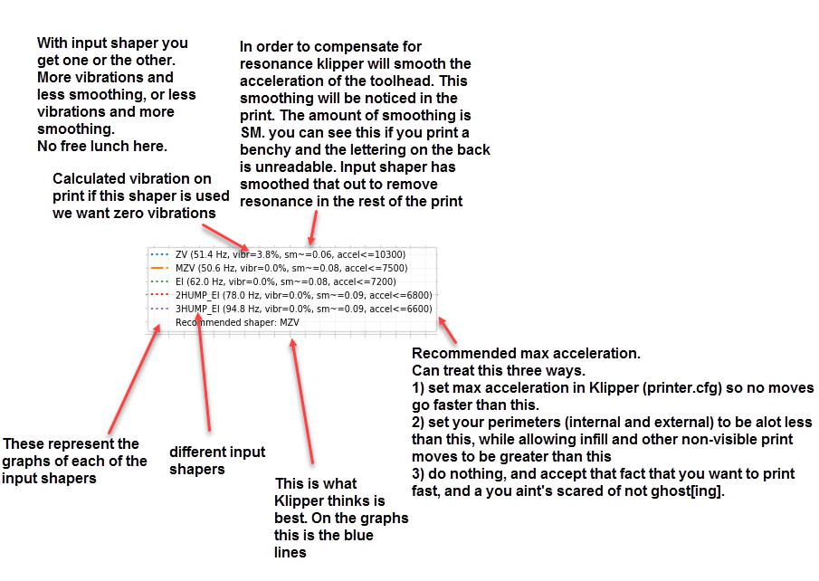
How to read input shaper graphs

Slide 12
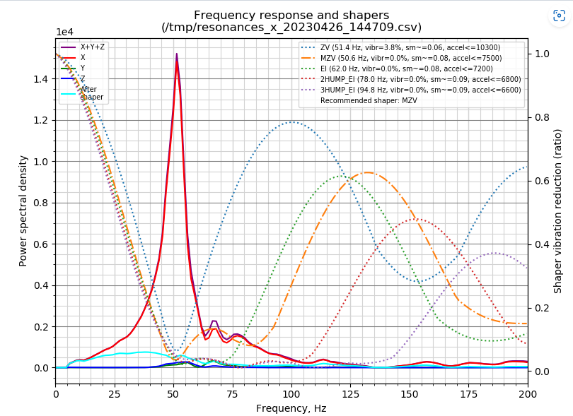
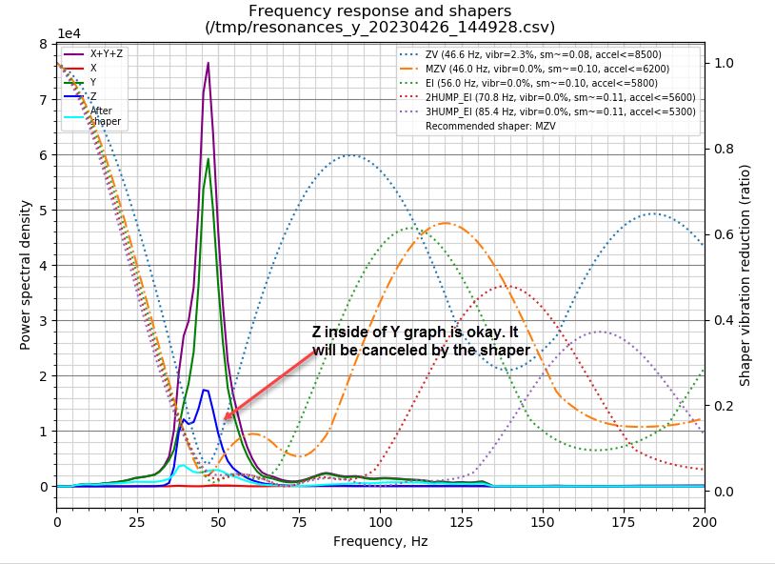
Good Graphs

Slide 13
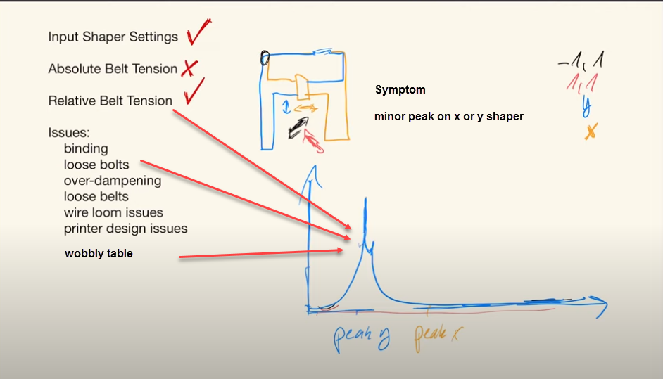
Binding, Relative Belt Tension, Wobbly table

Slide 14
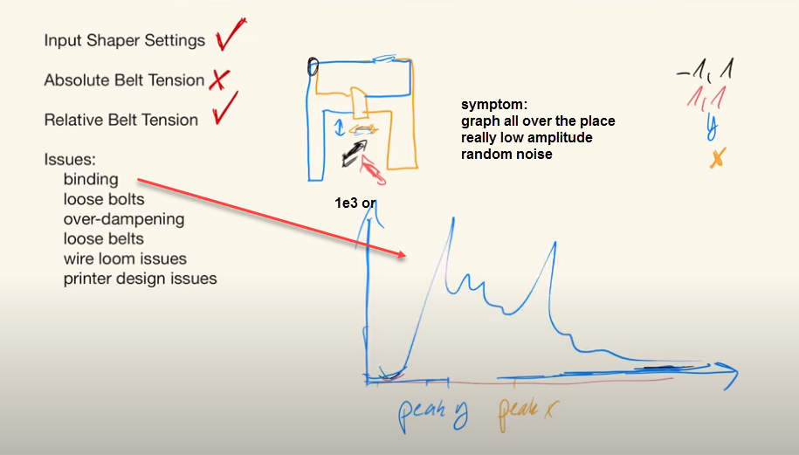
Binding

Slide 15
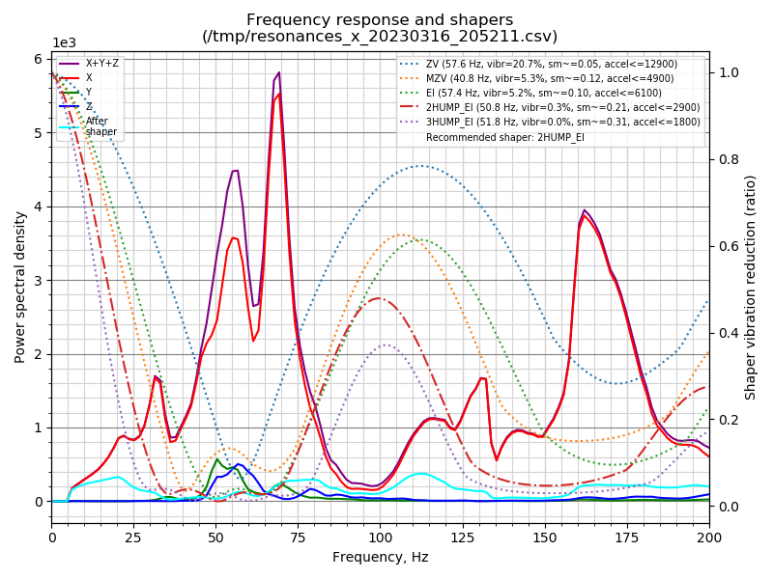
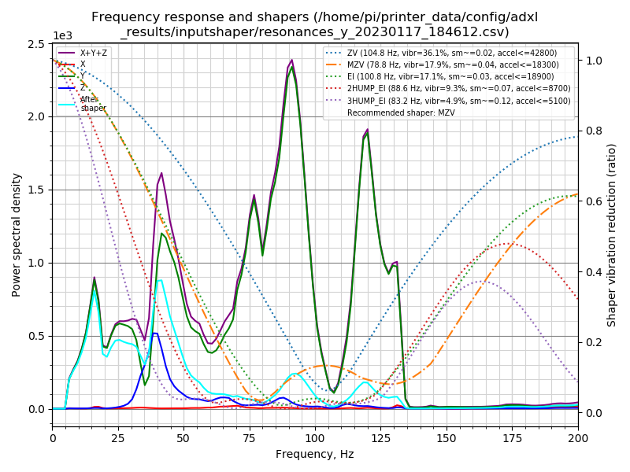
Binding, racking, wobbly table, etc. check every moving part start by placing printer on a stable surface (floor) then check belt path, then derack, then belt tension. If problem persist consider relubing linear rails, replacing bearings/idlers

Slide 16
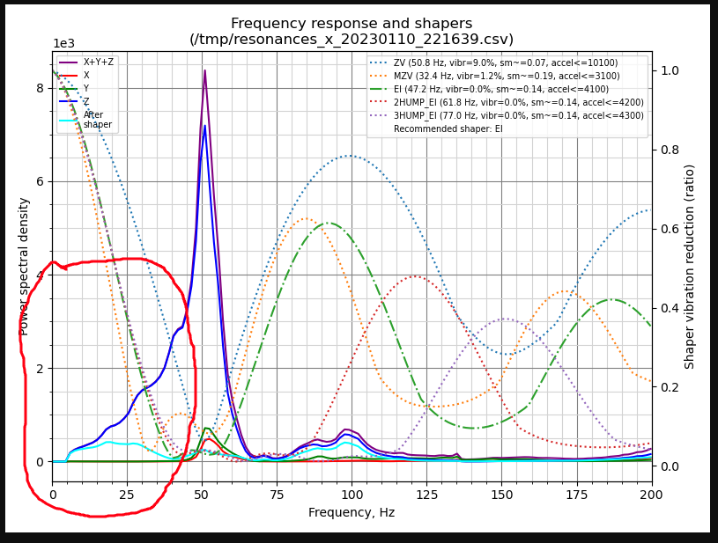
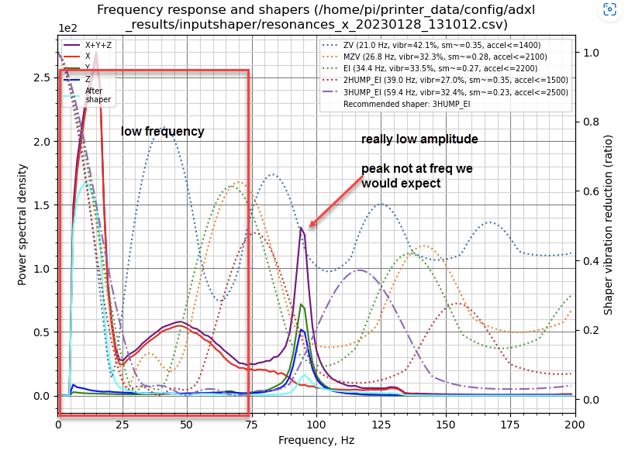
Low frequency – binding or grinding something is not moving freely check belt alignment (make sure you have the belt in the middle of the bearings, and not riding on the flange. Make sure bearings have the flange on the outside of the belt bath) Check linear rails, bearings, and idlers

Slide 17
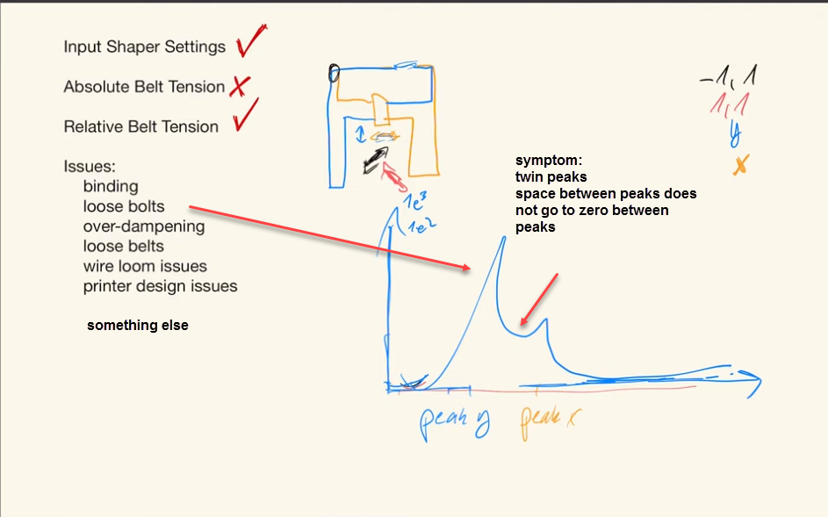
Loose Bolts

Slide 18
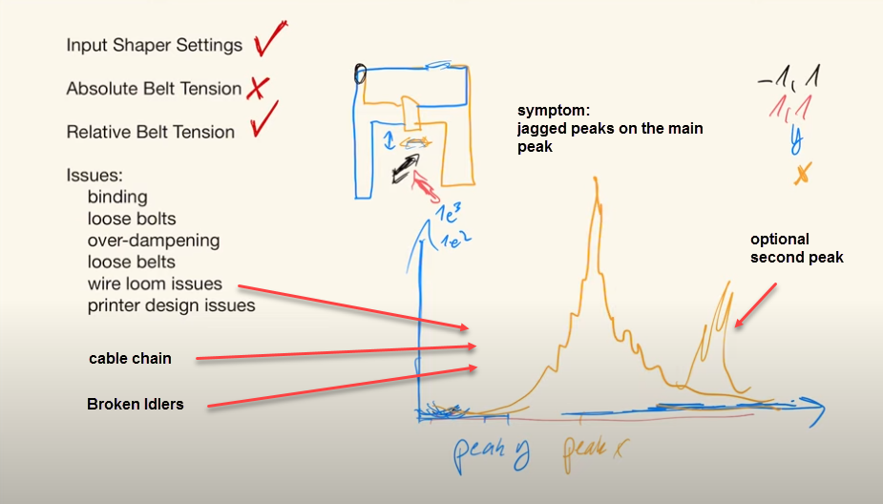
Wireloom/cable chain, Broken Idlers

Slide 19
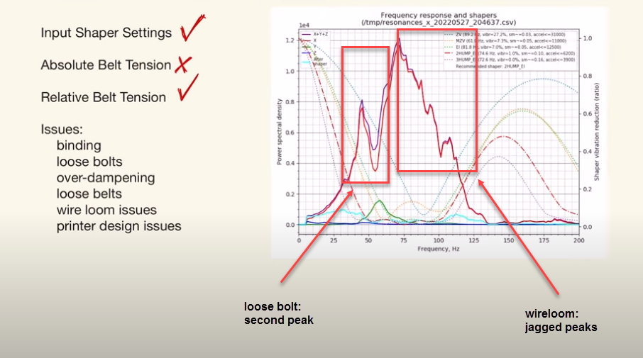
Wireloom and loose bolt

Slide 20
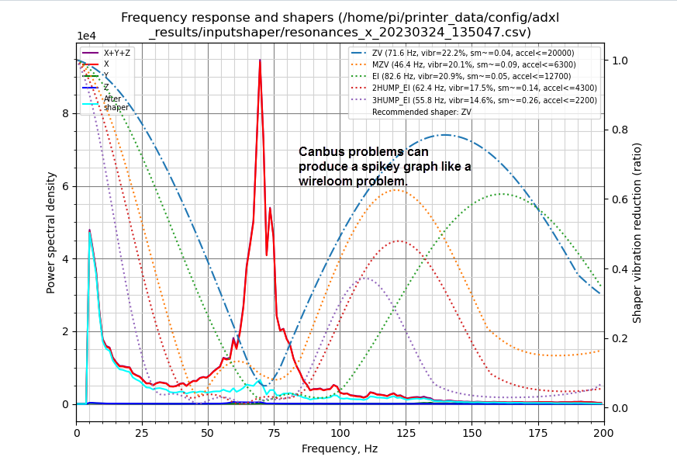
Canbus increase canbus speed to 1M (1 million dollars)

Slide 21
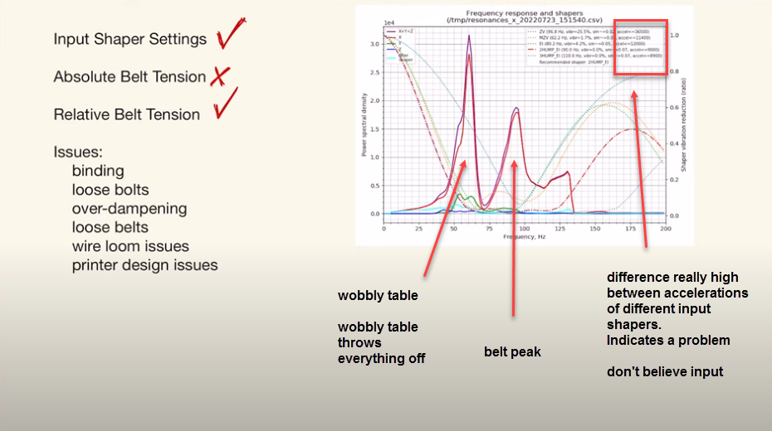
Wobbly table

Slide 22
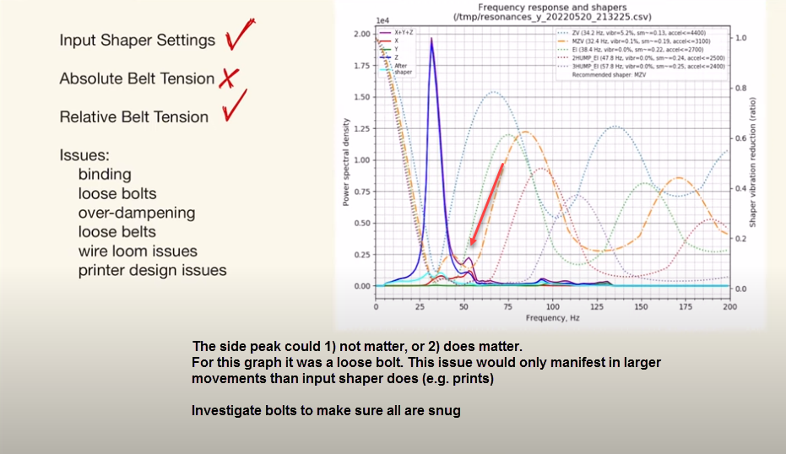
Potentially loose bolt or nothing at all

Slide 23
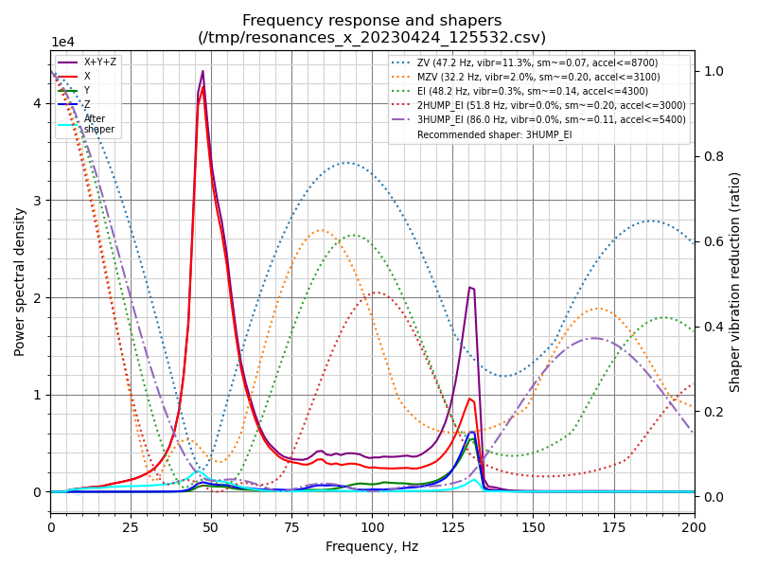
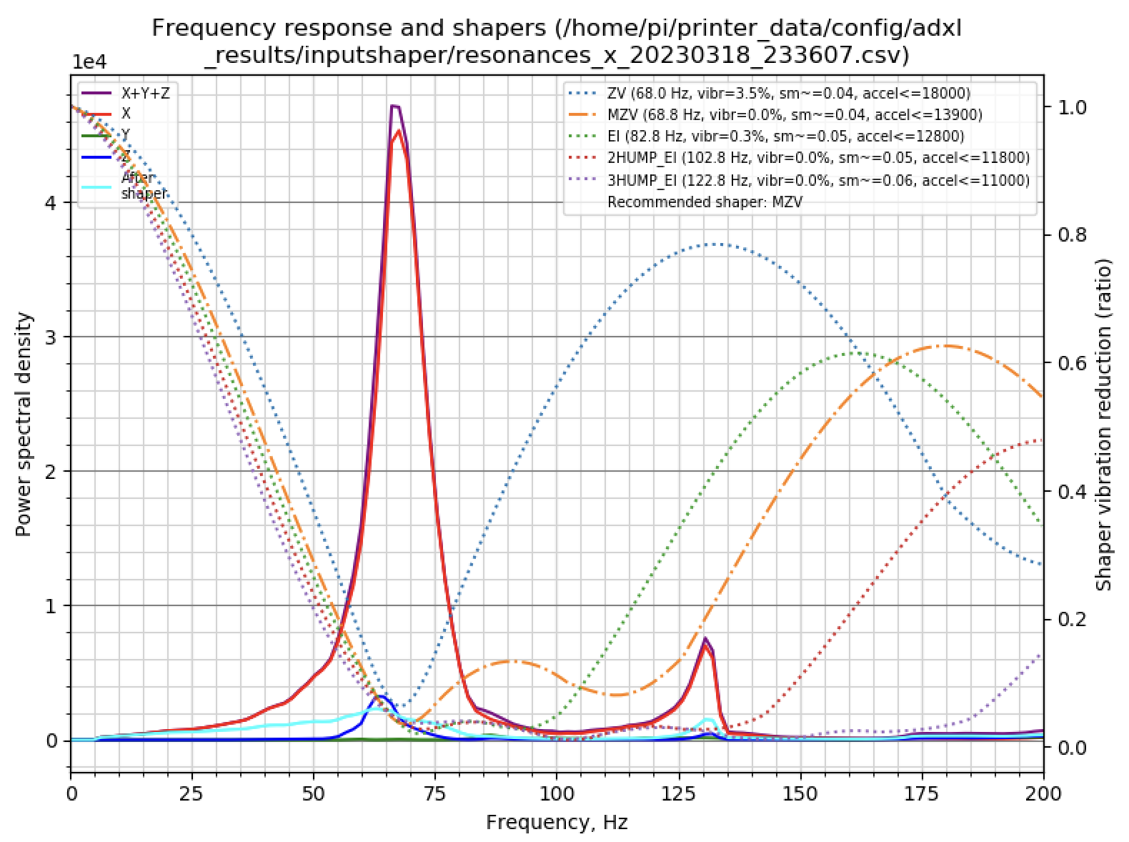
TAP Wobble toolhead in general
TAP issues are generally around 125hz and have the general shape shown above.
Toolhead issues are also associated with, but not exclusive to, 125hz.
If you see 125hz investigate the toolhead – break it down, and make sure all screws are tight, and your tap magnets are engaged.
Can have 125hz on non-tap machines also

Slide 24
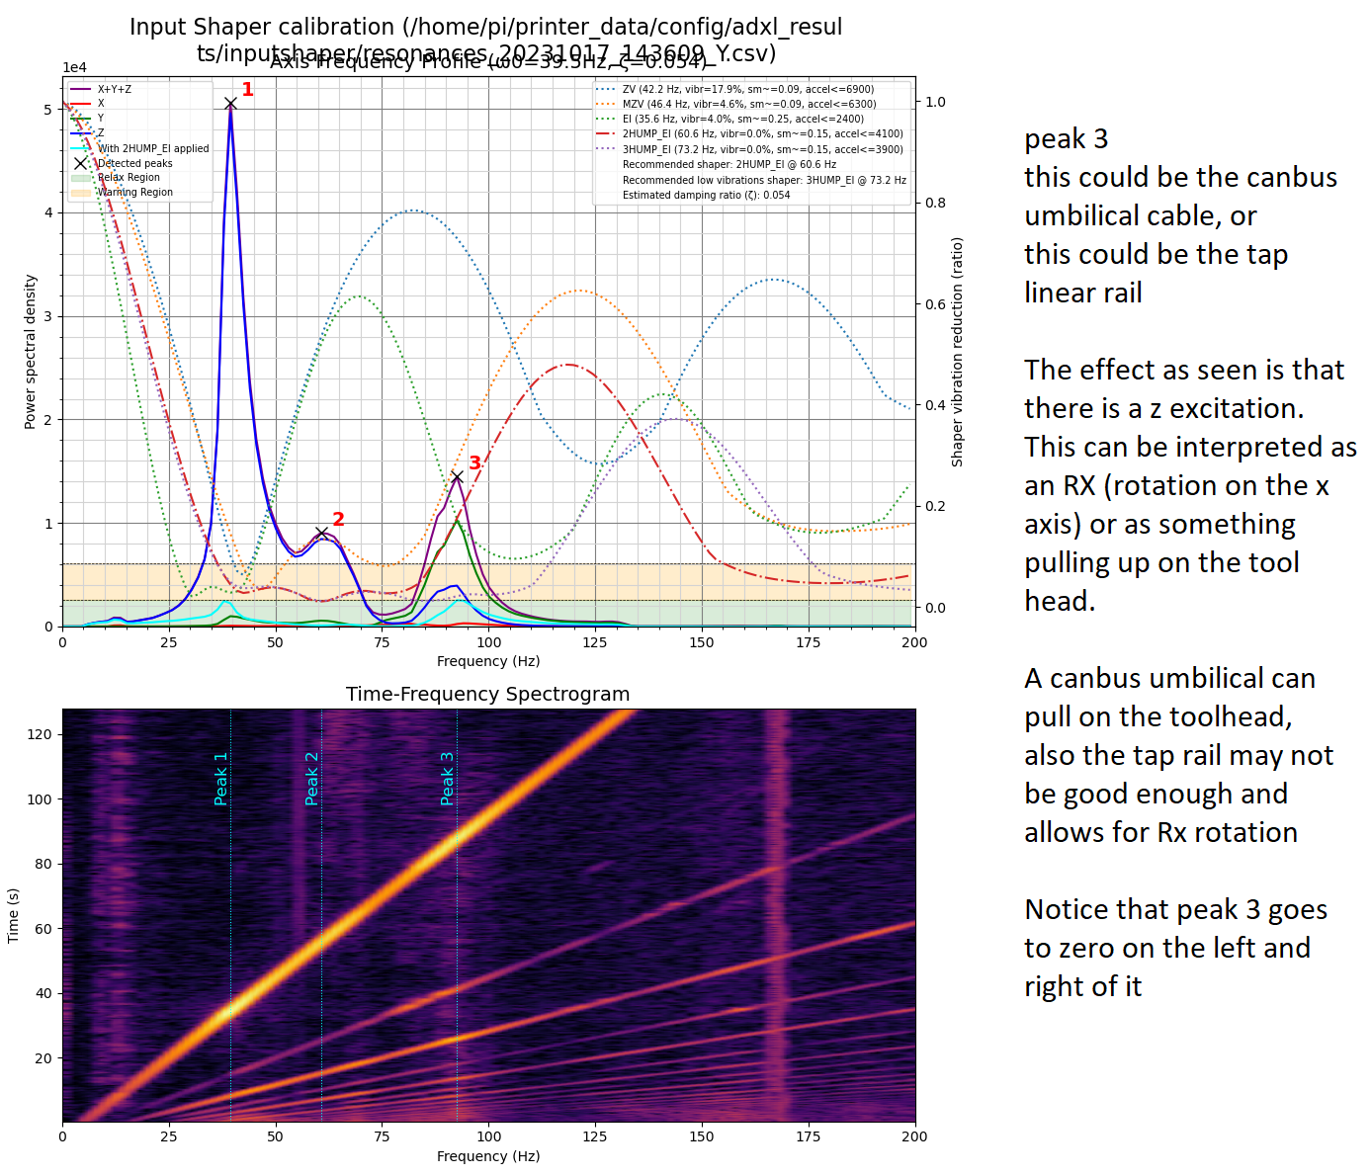
Canbus cable, or TAP linear rail

Slide 25
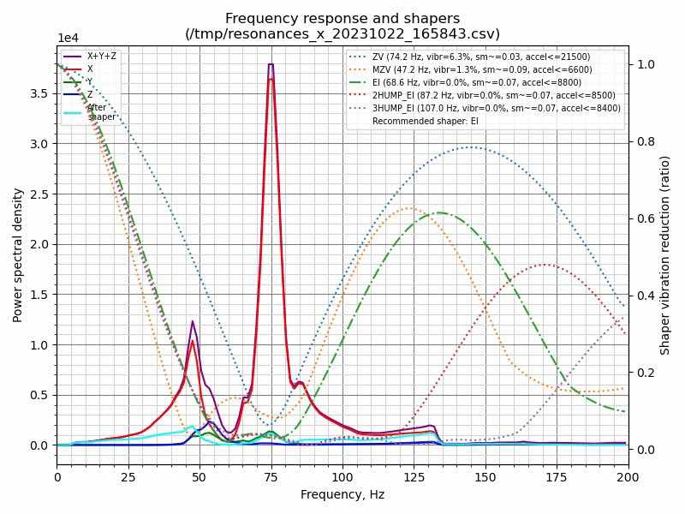
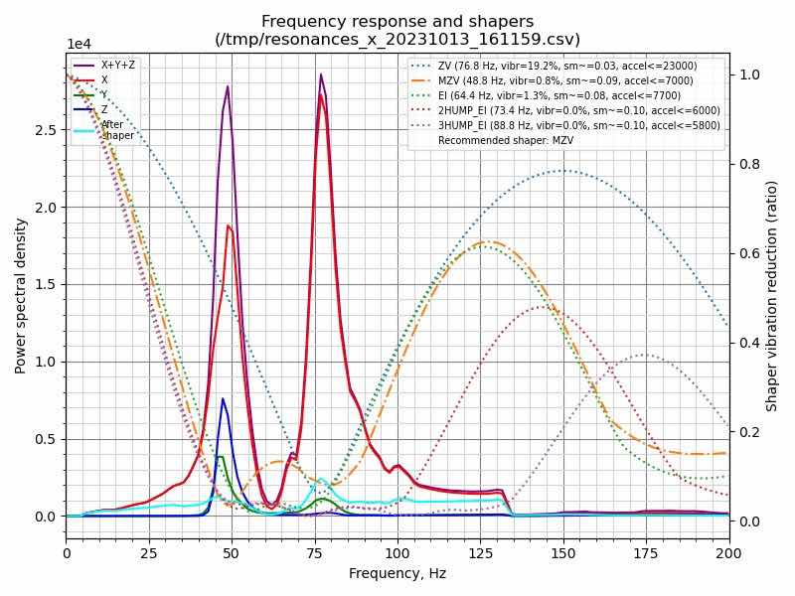
Potential Bearing issue What you see here is two peaks with a valley between then and the valley goes to zero. This is very similar to the canbus, tap, or linear rail. The difference is the amplitude of the 75 hz spike is equal to or greater than the real freq of around 50hz. -graphs by rafs2921

Slide 26
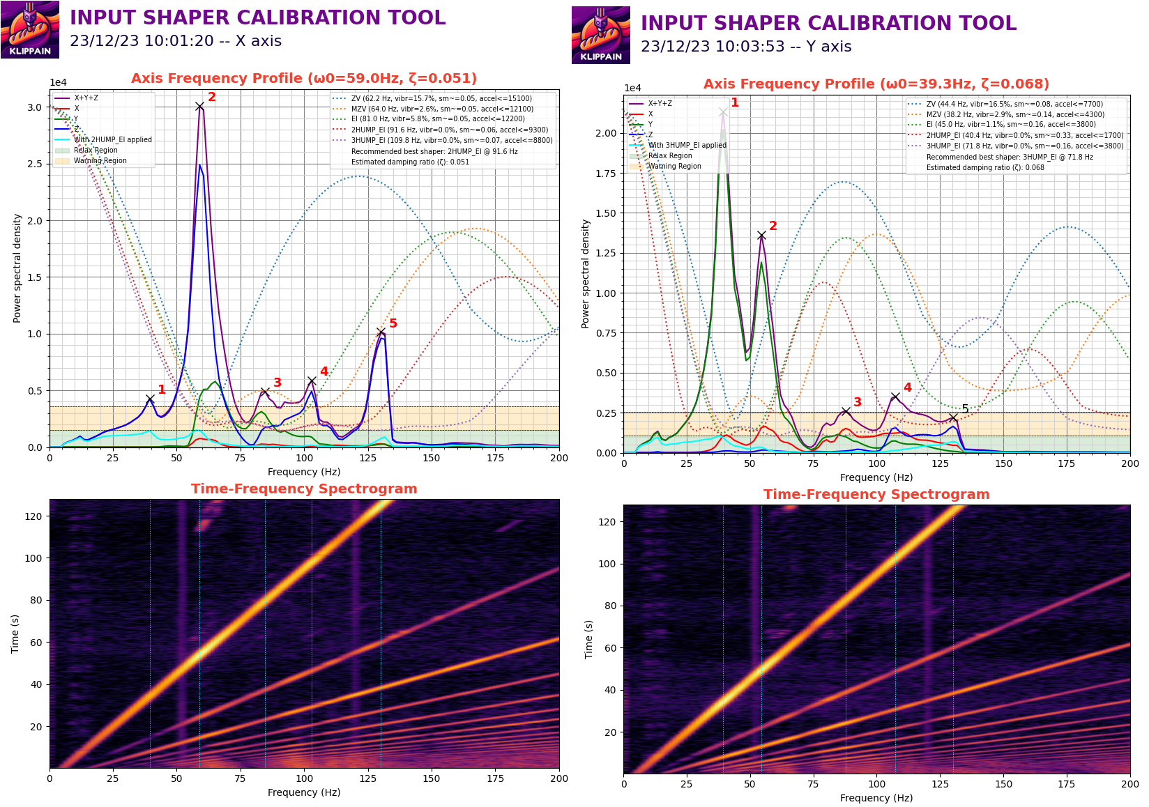
Not using all four screws to secure tap to the x-linear rail – missing two screws. Likely similar if screws are loose.

Slide 27
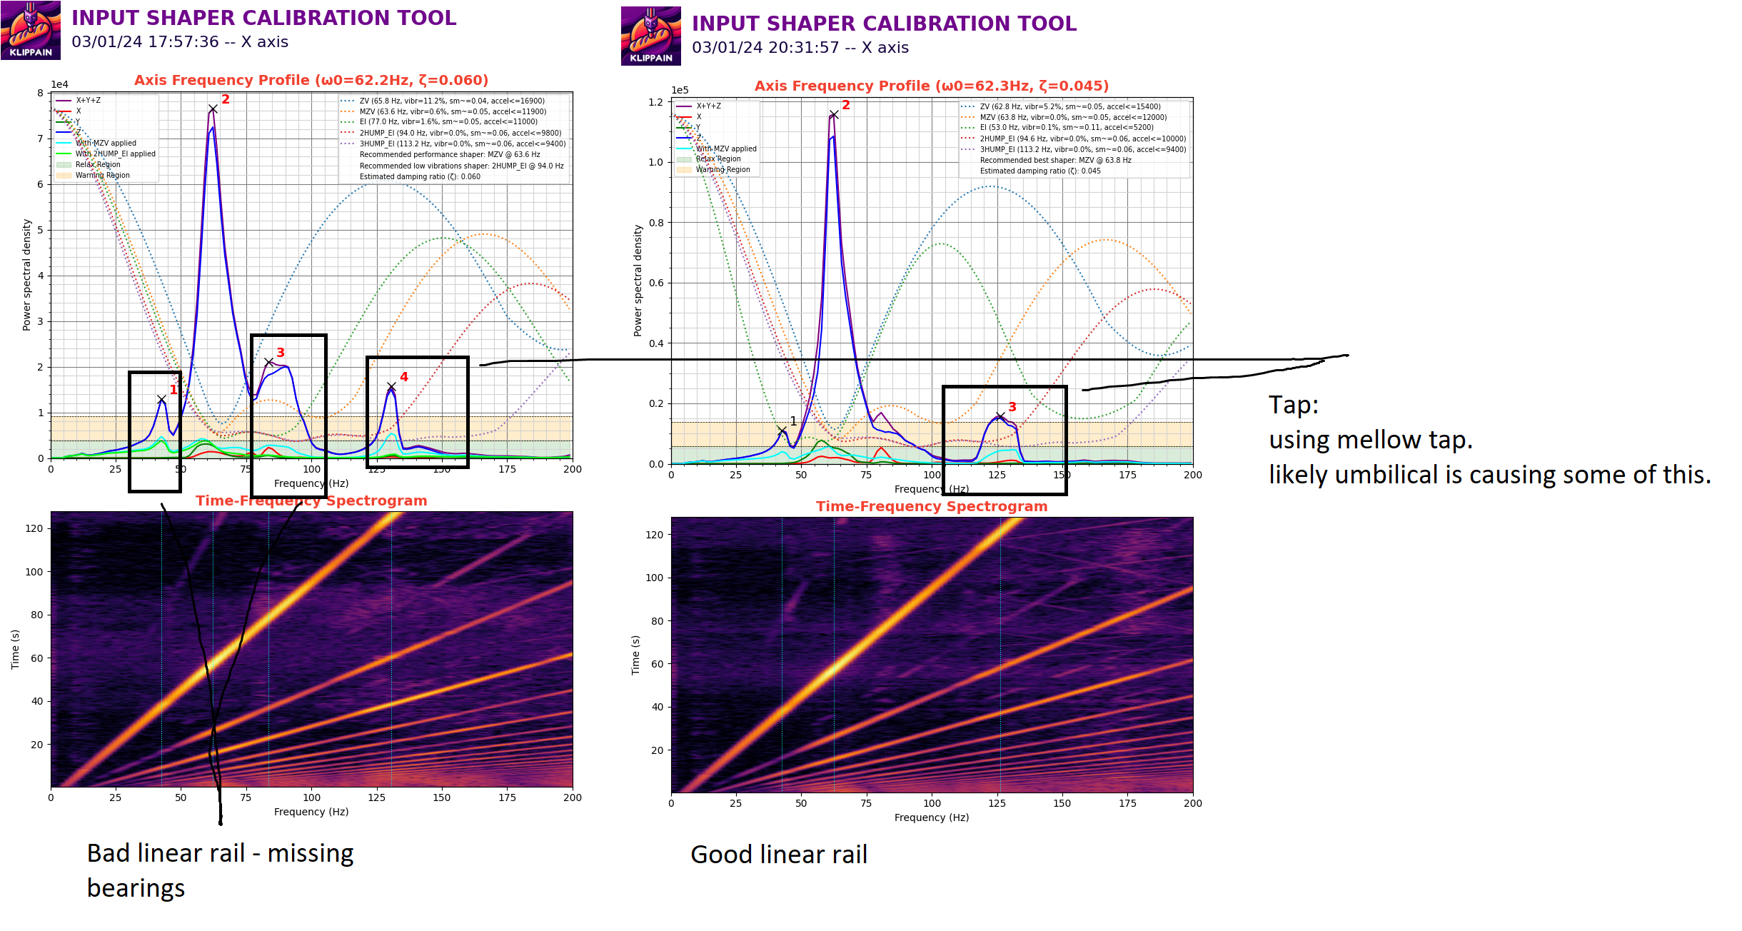
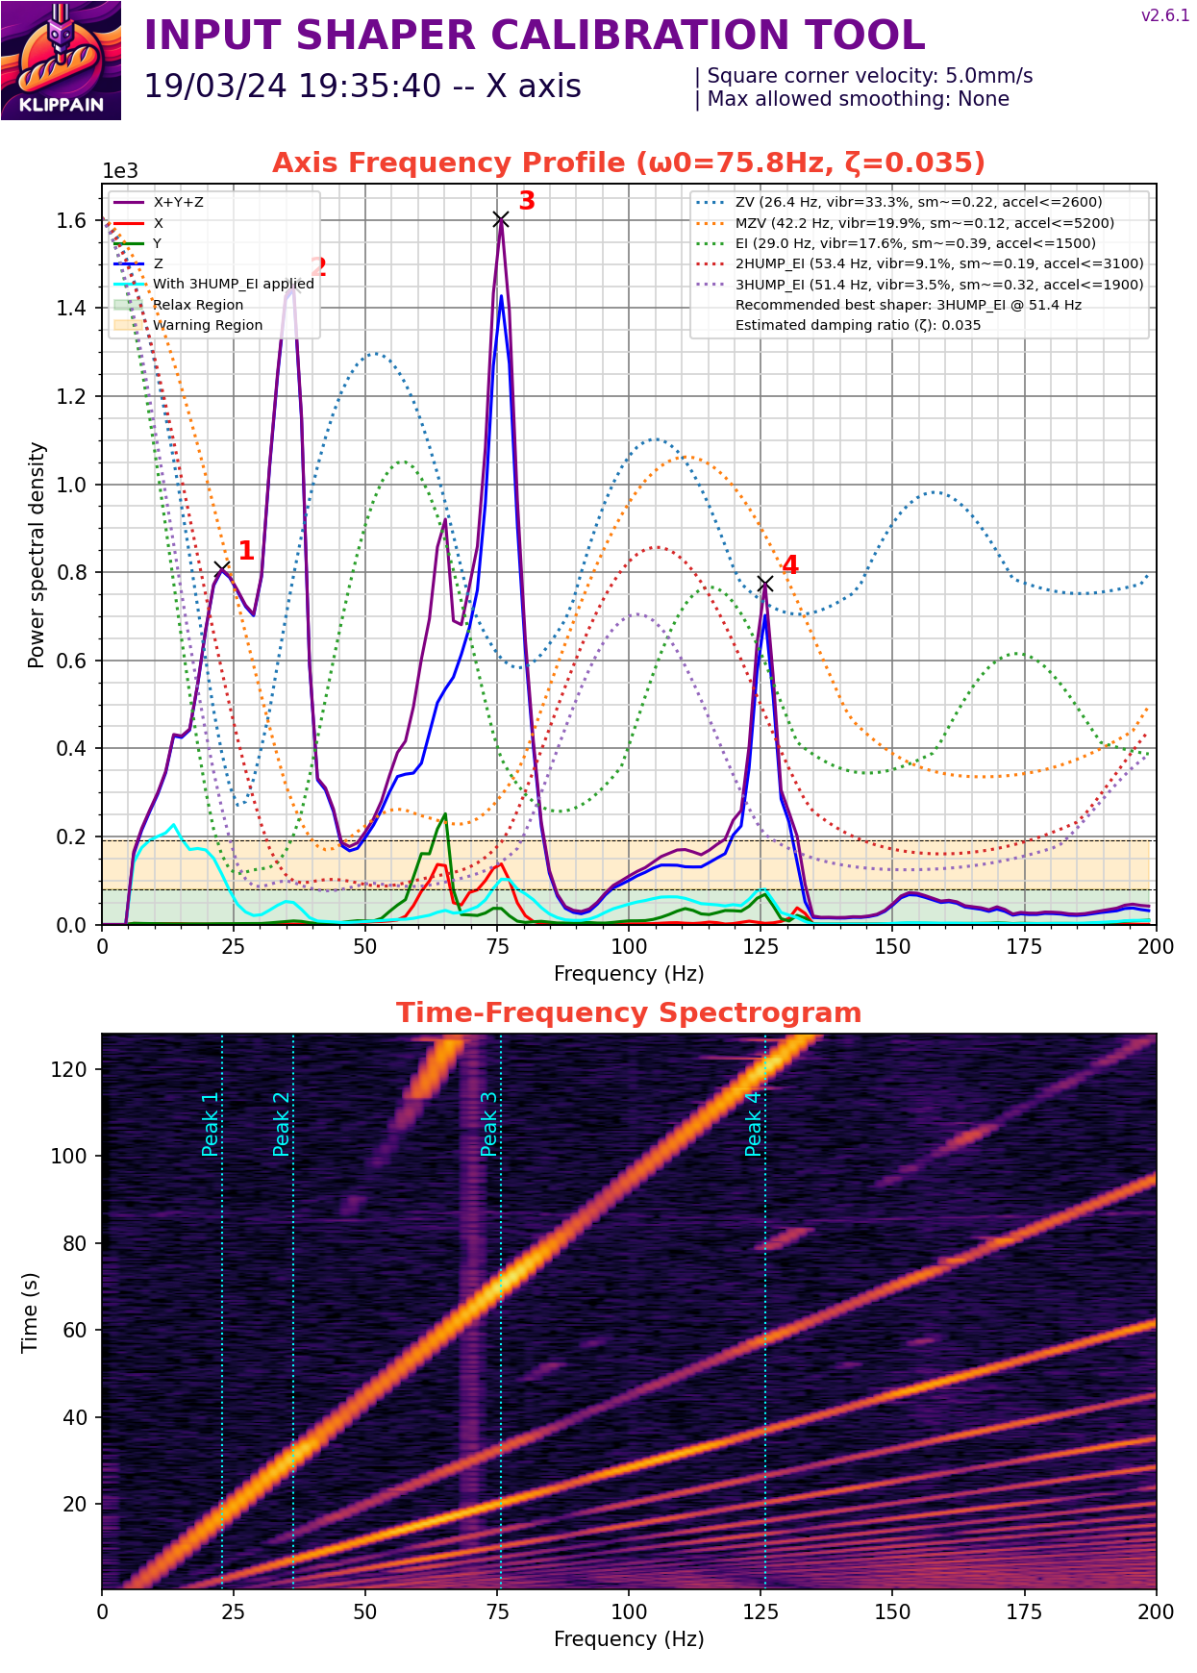
What a bad x-linear rail looks like. 125hz is not the x-linear rail

Slide 28
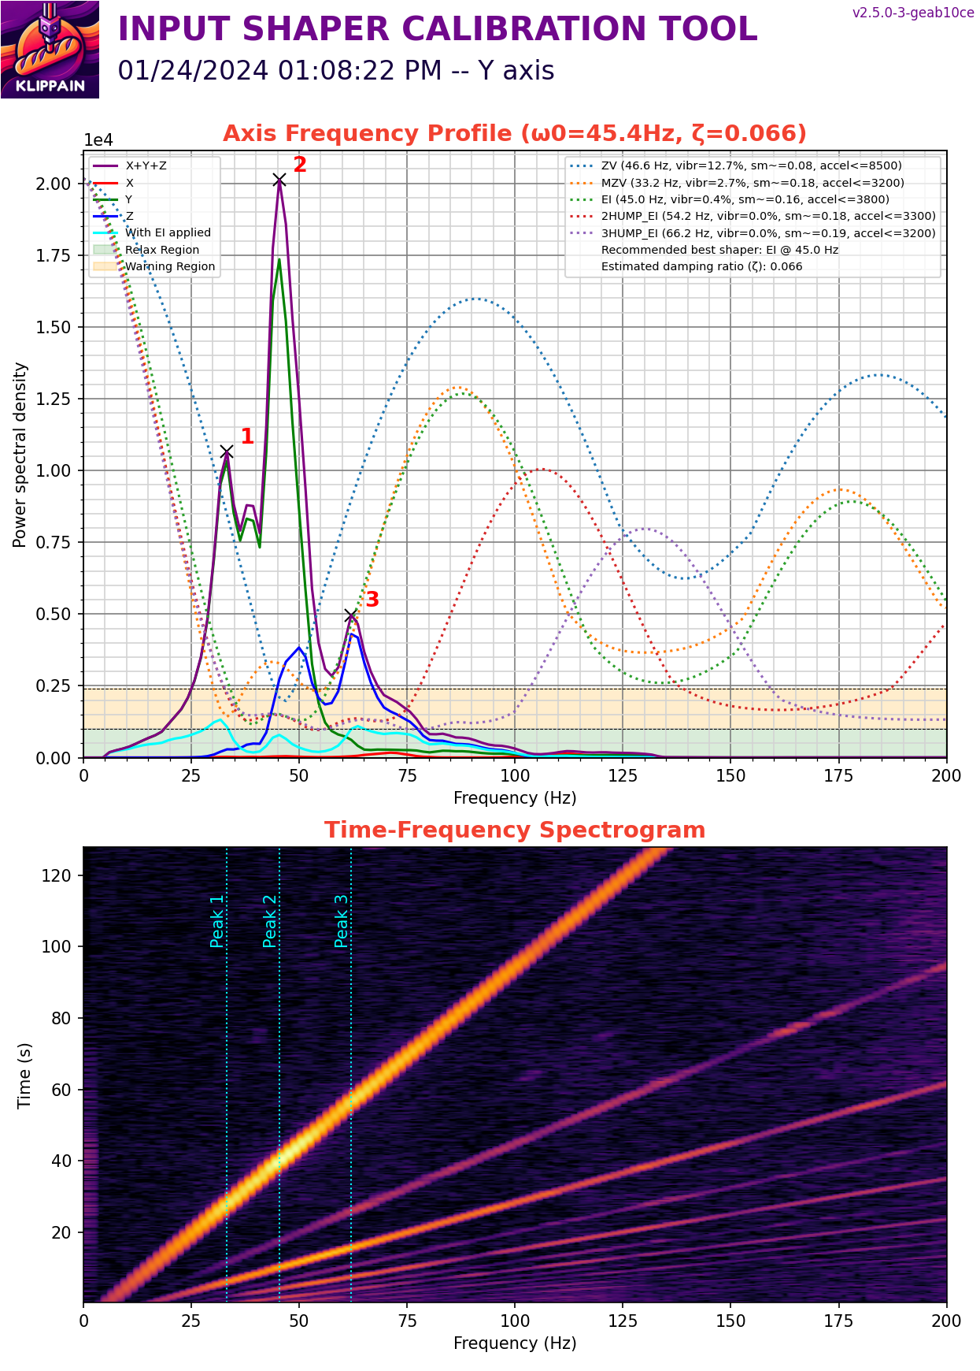
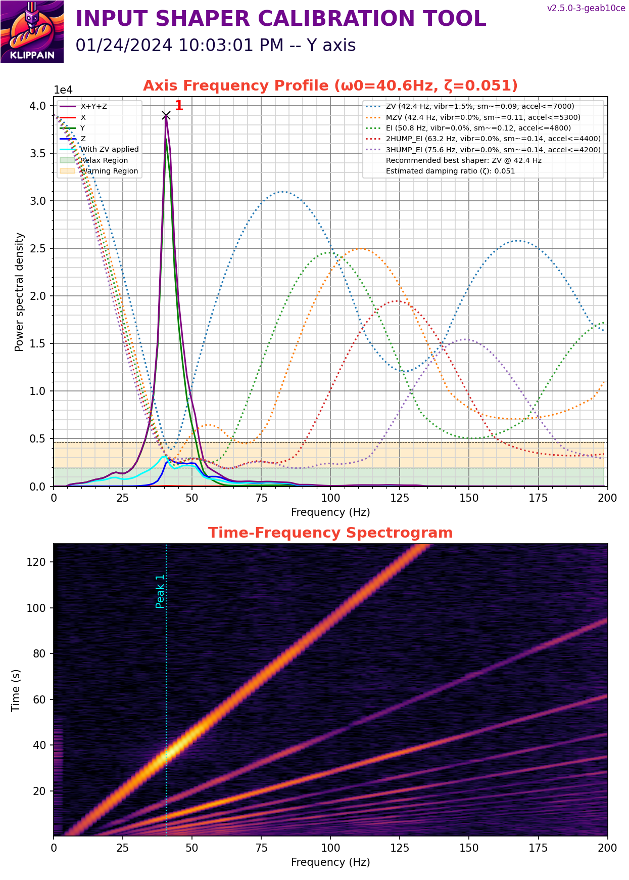
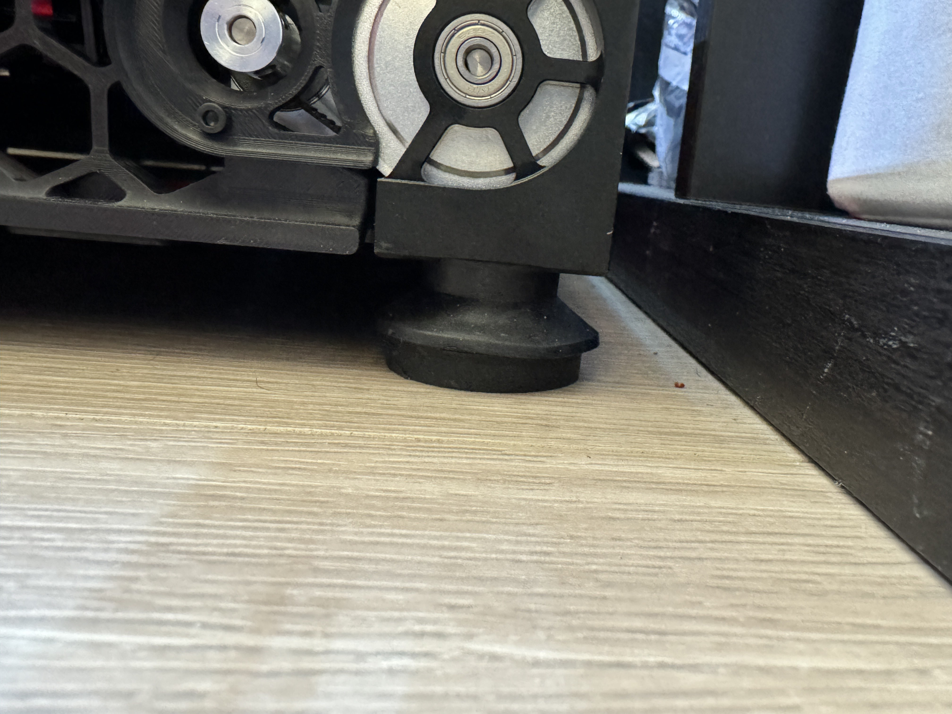
Printer wobbled on floor. Added dampers to the printer feet
Ioannis_gi V2.6589
Used: Raise It Isolation Feet for Speaker Vibration/Ventilation
As additional vibration damper

Slide 29
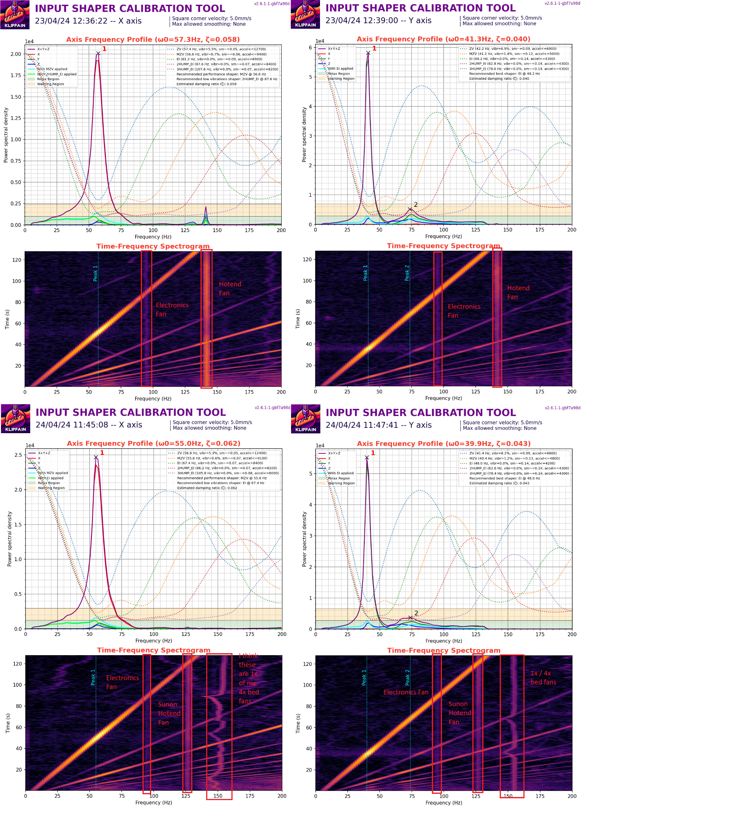
Fans effects on graphs by Nick|VS|V0|V2

